Slide 1
Delivery Route Optimization
SO group

Slide 2
SO Group : Special Optimizer Group
We named our team as Special Optimizer Group, in hope to build nice optimizer.
Shortly we call ourselves SO group, because it looks like rotation group in physics.
Our members are KwangJun Choi, BoSeong Kim, HeeKang Kim, JaeWon Choi. Our mentor is Takashi Imamichi. He helped us a lot. Thank you!
We solved Delivery Route Maximization(DRM) problem with Qiskit.

Slide 3
What is Delivery Route Optimization?
Suppose you want to sell your goods.
There are many customers, but you have only one vehicle.
Each customer has their own deadline.
You must sell your product before deadline.
You will want to maximize your profit.
Notes:
Summarize your research in three to five points.

Slide 4
Variable's detail
Variables | Detail
V_{i} | Node, representing customers and depot(V₀)
W_{ik} | Distance between V_{i} and V_{k}
T_{i} | Service time for V_{i}
s | Speed of the vehicle
C_{i} | Profit for V_{i}
D_{i} | Deadline for V_{i}

Slide 5
DRM is NP-Hard
DRM is proved to be NP-Hard problem.[1]
It is hard to get exact solution for large data.
But if we can be satisfied with good enough solution, we can have the optimized solution in reasonable time.
In this project, we will find an optimized solution for LDRM(Line DRM), which is DRM for 1 dimension.
To deal with LDRM, we should modify variables little bit.
Notes:
Summarize your research in three to five points.

Slide 6
Variable's detail
Variables | Detail
x_{ii} | Last destination is i-th customer
x_{ik} | Visited j-th customer when the last destination is i-th customer.
T_{i} | Service time for i-th customer
Dtemp_{i} | Time left when visit i-th customer
C_{i} | Profit for i-th custormer
D | Global deadline

Slide 7
Problem summary
Sum of x_{ii} should be 1. – Last destination is unique.
Only if x_{ii} is the last destination, vehicle can stop by airports before i-th airport.
Must meet deadline.
In these constraints, maximize profit.
Notes:
Summarize your research in three to five points.

Slide 8
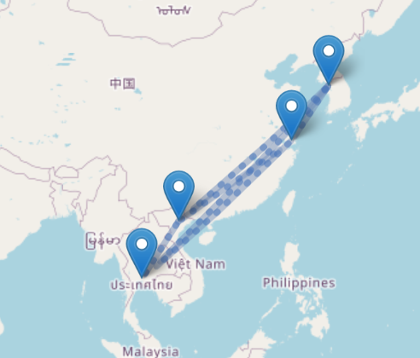
Real problem
As you can see, airports are on a line roughly.
You want to deliver your goods from airplane.
Your goods requires extremely cold environment and there is only one airplane available.
Airport for Incheon, Shanghai , Hanoi and Suvarnabhmi.

Slide 9
Procedure
Step 1
Define optimization problem in mathematics
Step 2
Add constraints in quadratic problem
Step 3
Qiskit will change quadratic problem into Ising model
Step 4
Solve the problem with Ising model
Notes:
List all of the steps used in completing your experiment.
Remember to number your steps.

Slide 10
Consideration in optimization
Optimization solution is not exact solution. Since QAOA is also an approximation if you want better solution, you may run program several times or set a parameter p.
As p goes large, the dimension goes large, then you will be likely to have better solution. But algorithm goes slower.
In VQE algorithm, intermediate data can be accessed by callback procedure. Alpha is a parameter of callback procedure that controls confidence level. Tuning alpha will give you better solution.

Slide 11
Conclusion
With Qiskit, optimization problems can be solved in reasonable time.
The solution may not be the best solution. There is trade-off for performance and solving time.
Optimization is sensitive to parameters. Parameters should be considered.
We tried for four nodes, but it requires 20 qubits. Though there is quantum computer which has more than 20 qubits, but it becomes difficult to run on quantum simulator. To optimize our algorithm, we may modify our equation more simply later.

Slide 12
Works Cited
[1] Chuanwen Luo, Deying Li, Xingjian Ding, Weili Wu, Delivery Route Optimization with automated vehicle in smart urban environment, Theoretical Computer Science 836(2020), 42-52
[2] Edward Farhi, Jeffrey Goldstone, Sam Gutmann, A Quantum Approximate Optimization Algorithm, arXiv:1411.4028

